Slide 1

Introduction to Databases
Lecture 1: Introduction to Databases and the Relational Model
Storing and Managing Information Efficiently
Dushko Todevski/ Databases 15.10.2024

Slide 2
What is a Database?
Definition: An organized collection of data, typically stored and accessed electronically.
Key characteristics: Persistent: Data is stored permanently.
Interrelated: Data is connected in meaningful ways.
Shared: Multiple users and applications can access the data concurrently.

Slide 3
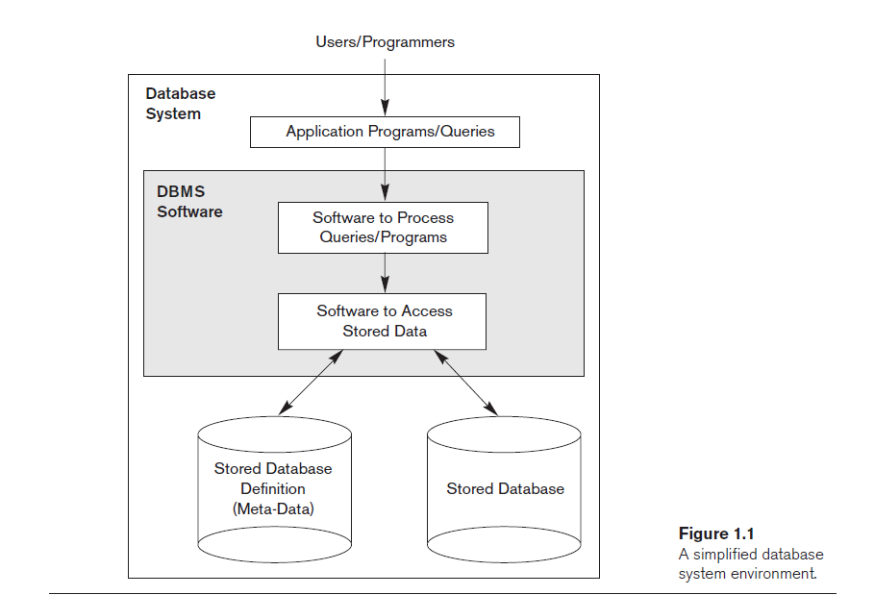
What is a Database?

Slide 4

Why are Databases Important?
Data is everywhere! Highlight the increasing volume and importance of data in various domains (business, science, social media, etc.).
Benefits of using databases: Data integrity: Ensures data accuracy and consistency.
Data efficiency: Reduces data redundancy and storage space.
Data sharing: Allows concurrent access and sharing of data.
Data security: Provides mechanisms for controlling access and protecting data.

Slide 5
What are databases used for?
Business Applications
Online Services
Scientific and Research
Data Analytics and Machine Learning
Other Applications???

Slide 6

Types of Databases
Relational Databases: (Focus of this course) Data is organized into tables with rows and columns.
Relationships between tables are defined using keys.
Examples: MySQL, PostgreSQL, Oracle, SQL Server.
NoSQL Databases: More flexible data models (key-value, document, graph).
Designed for specific types of data and applications.
Examples: MongoDB, Cassandra, Neo4j.
Other Database Types : Object-oriented databases: Combine object-oriented programming concepts with database management. Useful for complex data, but less common. (Imagine a multimedia database storing videos, images, and audio files)
Hierarchical databases: Tree-like structure. Windows file system

Slide 7
A Brief History of Databases
Early Days (pre-1960s):
Data was stored in physical formats: files, ledgers, punch cards.
Challenges: Data redundancy, inconsistency, difficulty in searching and updating.
Hierarchical Databases (1960s):
Data organized in a tree-like structure.
Example: IBM's Information Management System (IMS).
Network Databases (1960s):
More flexible than hierarchical, allowing many-to-many relationships.
Example: CODASYL databases.
Complexity: Navigating the network structure was challenging.
Relational Revolution (1970s):
Edgar F. Codd's relational model.
Organized data into tables with rows and columns.
SQL emerged as the standard query language.
Advantages: Flexibility, ease of use, data integrity.
Limitations: Rigid structure, difficult to represent complex relationships.

Slide 8
Database Evolution
Object-Oriented Databases (1980s):
Combined object-oriented programming concepts with database management.
Limited aption due to complexity.
NoSQL Databases (2000s):
Emergence of non-relational databases to handle big data and web-scale applications.
Focus on scalability, flexibility, and specific data types.
Cloud Databases (2010s):
Databases hosted and managed in the cloud.
Scalability, cost-effectiveness, and ease of access.
Distributed Databases (Present):
Data distributed across multiple nodes for improved performance and reliability.

Slide 9
Actors on the database scene
Database Designers
Database Administrators
End Users
What about software engineers?

Slide 10
The Relational Model
Introduced by Edgar F. Codd in 1970.
Based on mathematical set theory.
Organizes data into relations (tables).
Key components:
Entities: Real-world objects or concepts (e.g., students, courses, books).
Attributes: Properties or characteristics of entities (e.g., student name, course ID, book title).
Relationships: Connections between entities (e.g., students enroll in courses, books are borrowed by students).

Slide 11
Entities and Attributes
Entity: Represented by a table.
Attributes: Represented by columns in the table.
Example:
Entity: Student
Attributes: StudentID, Name, Major, Age

Slide 12
Relationships
Types of relationships:
One-to-one: One instance of an entity is related to one instance of another entity (e.g., one student has one student ID card).
One-to-many: One instance of an entity is related to multiple instances of another entity (e.g., one course can have many students).
Many-to-many: Multiple instances of an entity are related to multiple instances of another entity (e.g., students can enroll in many courses, and courses can have many students).

Slide 13
Keys
Candidate Key: A minimal set of attributes that uniquely identifies a row in a table.
Primary Key: One candidate key chosen to be the main identifier for a table.
Foreign Key: An attribute in one table that refers to the primary key of another table, creating a relationship between the tables.

Slide 14
Keys
From candidate key to primary key to foreign key
CustomerID | Email | PhoneNumber | Name
1 | alice@mailinator.com | 555-1234 | Alice
2 | bob@mailinator.com | 555-5678 | Bob
3 | NULL | 555-9012 | Carol
4 | dusko@mailinator.com | NULL | David
CustomerID (PK) | Name | Email
1 | Alice | alice@mailinator.com
2 | Bob | bob@mailinator.com
OrderID (PK) | CustomerID (FK) | OrderDate | Amount
101 | 1 | 2024-10-26 | 100
102 | 2 | 2024-10-26 | 50
103 | 1 | 2024-10-27 | 75

Slide 15
Keys
From candidate key to primary key to foreign key
CustomerID | Email | PhoneNumber | Name
1 | alice@mailinator.com | 555-1234 | Alice
2 | bob@mailinator.com | 555-5678 | Bob
3 | NULL | 555-9012 | Carol
4 | dusko@mailinator.com | NULL | David
CustomerID (PK) | Name | Email
1 | Alice | alice@mailinator.com
2 | Bob | bob@mailinator.com
OrderID (PK) | CustomerID (FK) | OrderDate | Amount
101 | 1 | 2024-10-26 | 100
102 | 2 | 2024-10-26 | 50
103 | 1 | 2024-10-27 | 75

Slide 16
Example: Library Database
Entities: ??????????????????
Attributes:
Books: ?????????????
Members: ????????????????
Loans: ??????????????
Relationships:
?????????????????????

Slide 17
Example: Library Database
Entities: Books, Members, Loans
Attributes:
Books: BookID, Title, Author
Members: MemberID, Name, Address
Loans: LoanID, BookID, MemberID, LoanDate
Relationships:
Members borrow Books (one-to-many).
Loans connect Books and Members.

Slide 18
Example: Student Enrolment system
Exercise
Instructions: Design a simple database schema on paper for a student enrollment system.
Entities: Students, Courses, Enrollment
Think about:
What attributes should each entity have?
What are the relationships between the entities?
What are the candidate keys and primary keys?

Slide 19
Q&A and Discussion

Slide 20
Thanks for the attention!

